Slide 1


Transition States and Molecular Motors:
Internal Coordinates and Molecular Mechanics
Notes:
Transition States and Molecular Motors:
Internal Coordinates and Molecular Mechanics

Slide 2
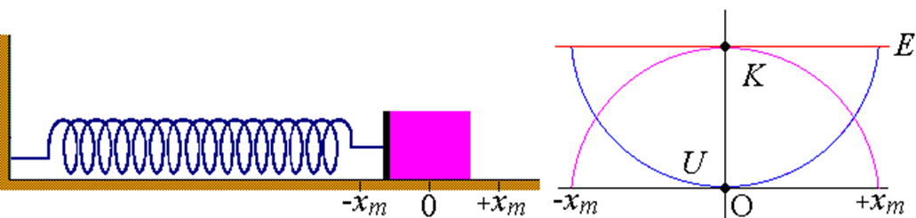
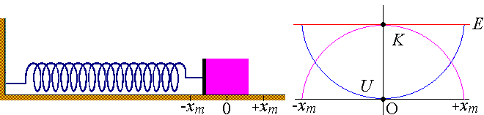
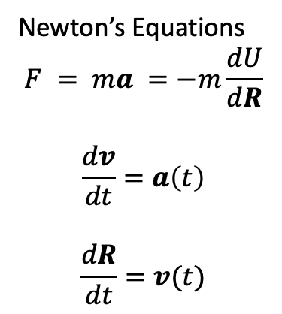
Review of Classical Physics
Molecules behave very similarly to masses on a spring.
Newton’s Equations
$$F = ma =−m\frac{dU}{dR}$$
$$\frac{dv}{dt}=a\left(t\right)$$
$$\frac{dR}{dt}=v(t)$$
Several numerical procedures to integrate:
Velocity Verlet, Rungge Kutta, Midpoint Formula
Can also add things like barostats and thermostats to control the pressure and temperature of the ensemble

Slide 3
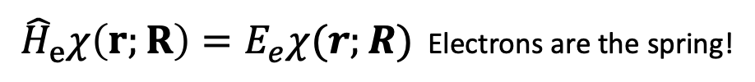
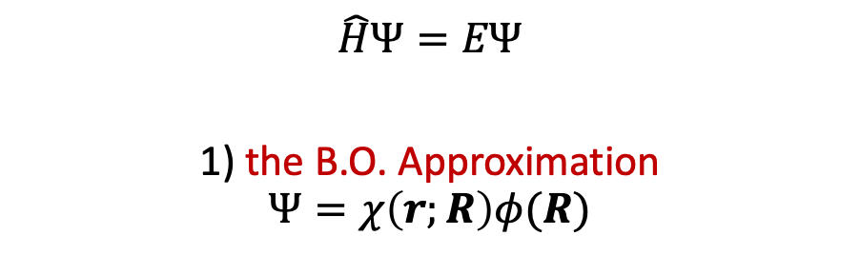
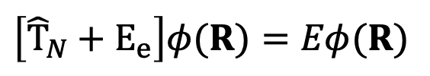
Key Approximations in Computational Chemistry
$$\hat{H}Ψ=EΨ$$
1) the B.O. Approximation
$$Ψ=χ\left(r;R\right)φ(R)$$
aka Molecular Mechanics
${\hat{H}}_{e}χ\left(r;R\right)=E_{e}χ(r;R)$ Electrons are the spring!
Equilibrium terms
r_{eq} : bonds
θ_{eq} : angles
n : dihedral multiplicity
γ : dihedral phase
Force Constants
Kr : bonds
K_{θ} : angles
V_{n} : dihedral
$$\left[{\hat{T}}_{N}+E_{e}\right]φ(R)=Eφ(R)$$
Nuclei are the masses!
hard to solve for many degrees of freedom →
2) Treat Nuclei classically
Hard to solve electronic energy (e.g. DFT, or HF)
3) Treat nuclei and electrons classically

Slide 4
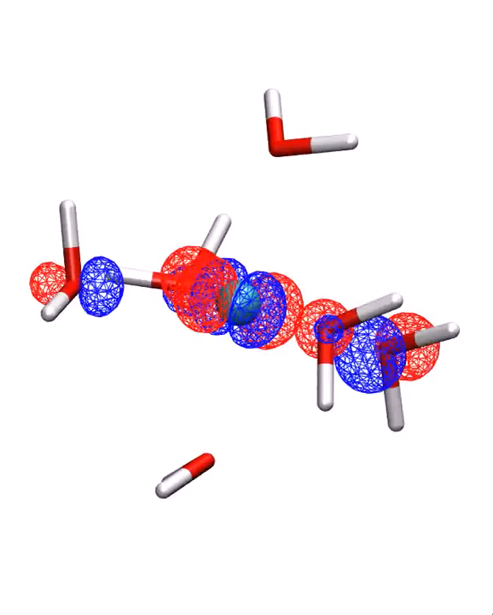
Discussion
What are the limitations of Molecular Mechanics?
Molecular mechanics cannot explain bond forming or breaking
Is strictly empirical
What Kind of Simulation is this?
Ab Initio BOMD of Cu(II)
Coutesy of Christopher Rowley,

Slide 5
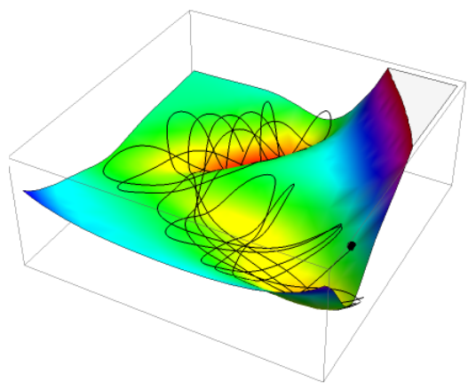
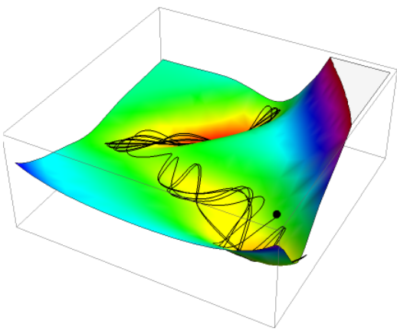
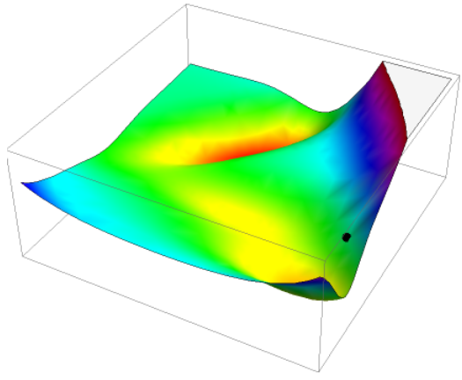
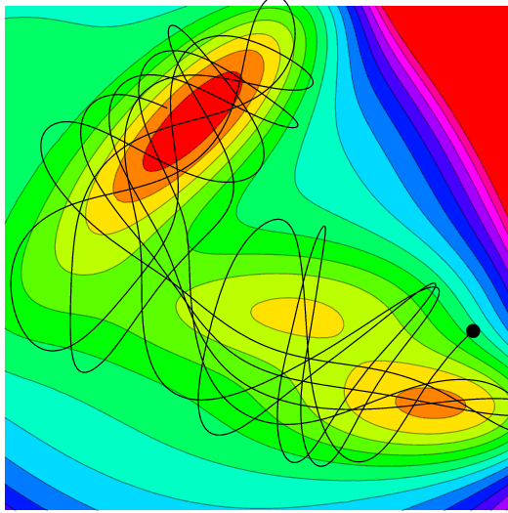
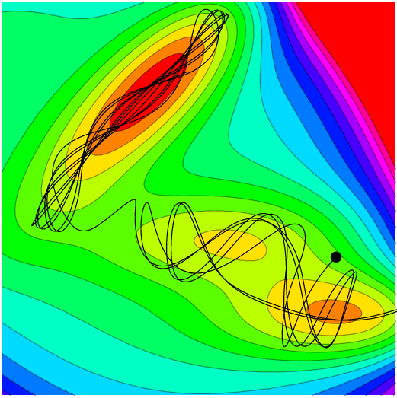
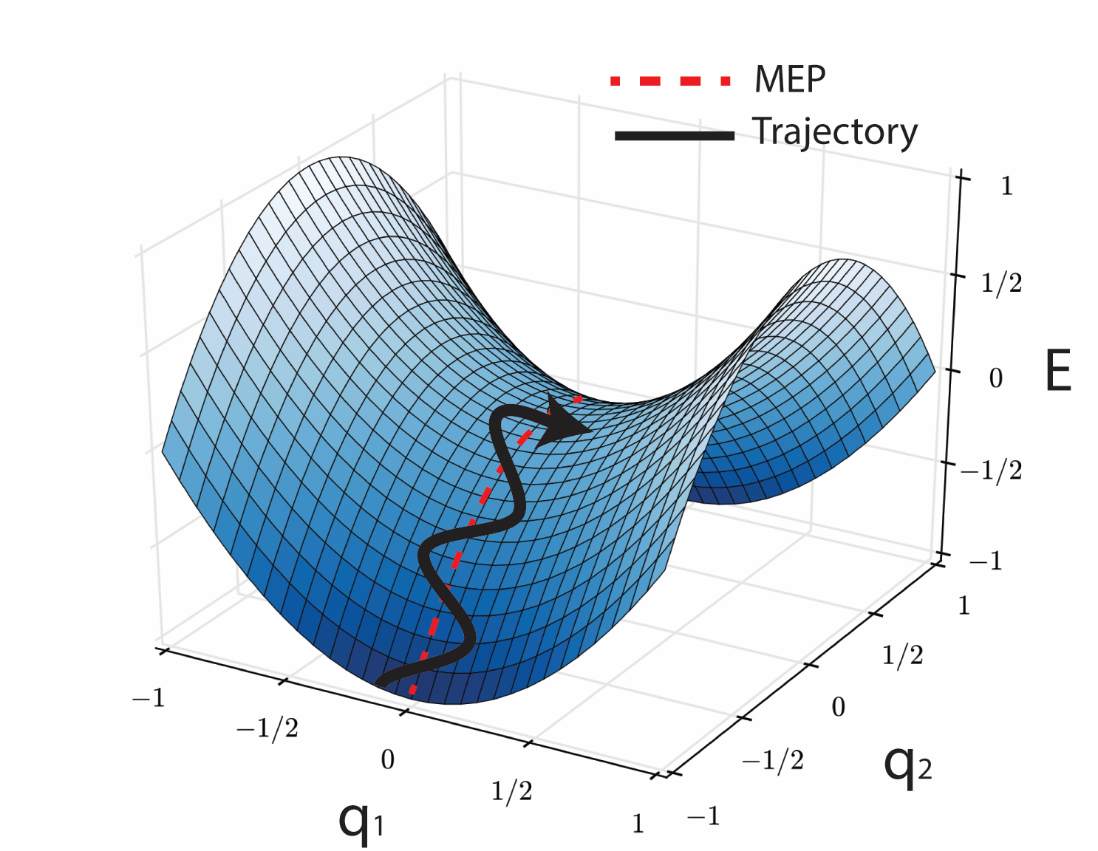
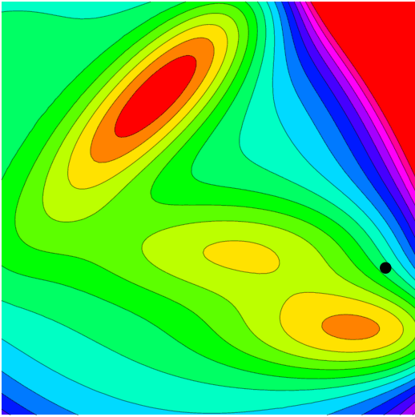
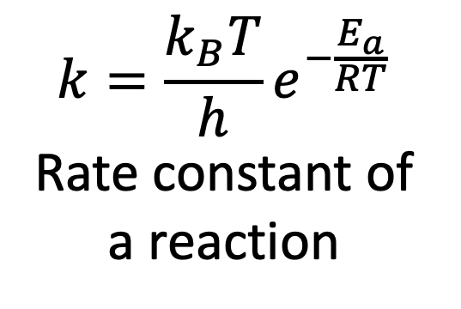
Molecular Dynamics and Transition States
$$k=\frac{k_{B}T}{h}e^{−\frac{E_{a}}{RT}}$$
Rate constant of a reaction
Trajectory must have enough energy to cross. Most trajectories do not cross
TS theory allows us to bypass expensive molecular dynamics!
Transition state
Galen Craven, Trajectories on the Müller-Brown Potential Energy Surface

Slide 6
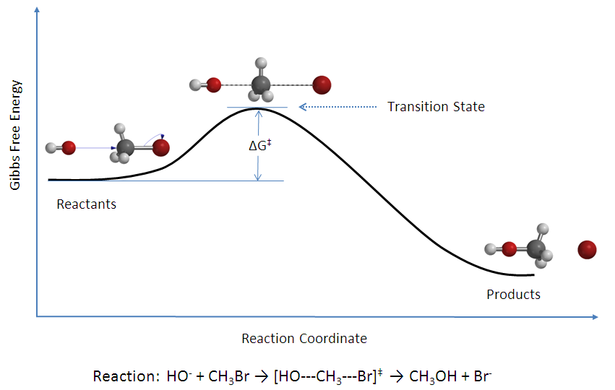
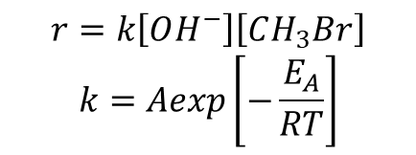
$$r=k\left[OH^{−}\right]\left[CH_{3}Br\right]$$
$$k=Aexp\left[−\frac{E_{A}}{RT}\right]$$

Slide 7
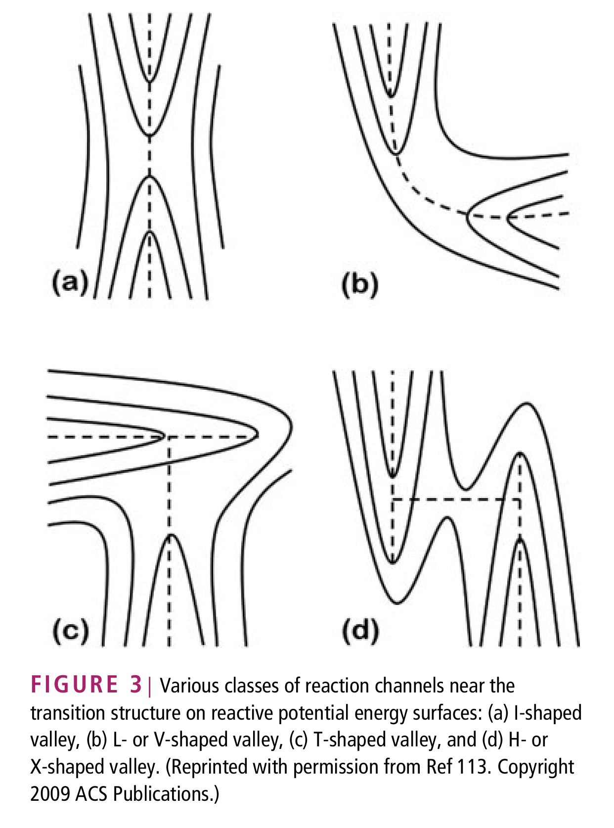
Process for TS finding relatively difficult
Multiple TS present
Many TS types
Mathematically
first order saddle point “pringles chip”
Lowest path between reactant valley and product valley is reaction path
Calculation strategies
Opt TS from guess structure
Requires calculating IRC (intrinsic reaction path)
Single Ended
Double Ended
Fukui, K. Acc. Chem. Res., 1981, 14, 363.; Kraka, E. WIREs Comput Mol Sci, 2011, 1, 531

Slide 8
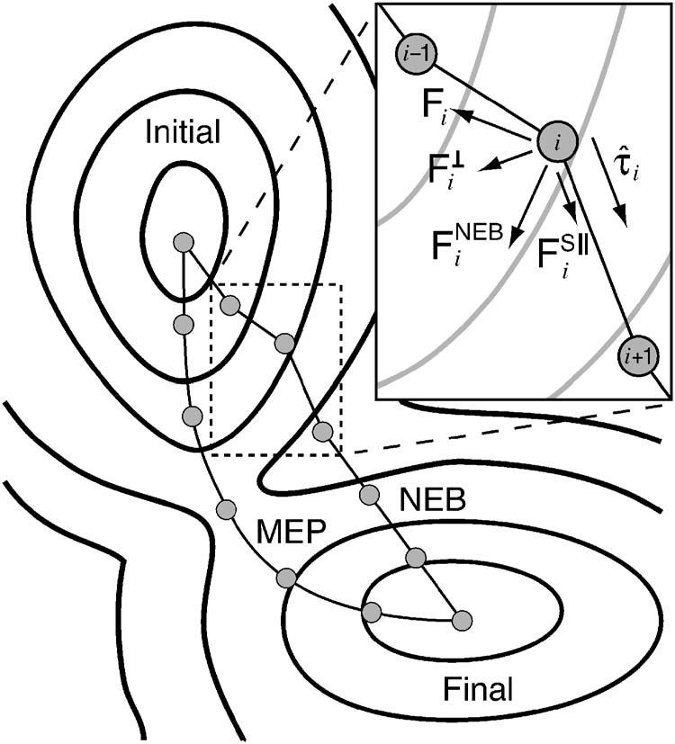
Methods: Double Ended
Constrained Quasi-Newton (Needs 2 or more ends…)
QST2 requires 2
QST3 requires 3
Uses either linear or quadradic synchronous transit to interpolate between points (fixes interpolation issue in Cartesian coordinates)
Nudged Elastic Band
Creates artificial forces parallel to string that keeps images separated along path
String Methods
String Method
Double-Ended Growing string method (GSM)

Slide 9
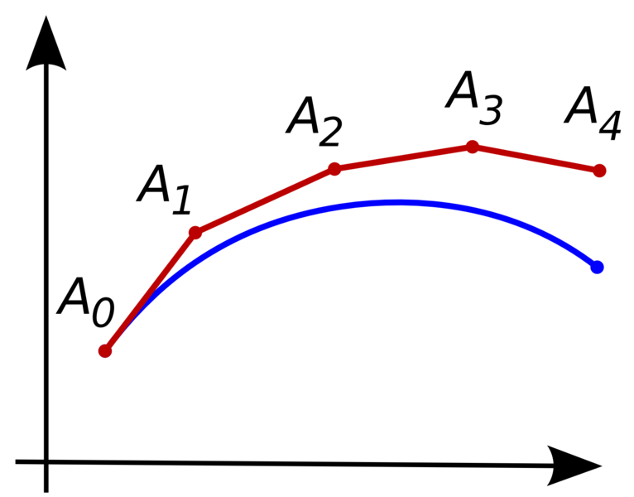
Methods: Single Ended
Coordinate Pushing
Directed by constrained optimization
Shallowest Ascent
Dimer method
The “dimer” is formed by two images very close to each other on the PES. The method works by moving the dimer uphill from the starting position whilst rotating the dimer to find the direction of lowest curvature (ultimately negative).
Single-Ended growing String Method
Coordinate pushing with internal coordinates
Peng CY, Schlegel HB. Isr J Chem 1993, 33 : 449–454.
Notes:
The concept behind single ended methods is to explore the PES without bias toward any one particular direction. Theoretically one should be able to find the TS by going uphill from the SM or products and locate new valleys associated with a SM/product.
Problem, all directions from start in a valley are uphill, most will end at higher order TSs
If main coordinate changes throughout the TS the coordinate pushing may not work well…

Slide 10
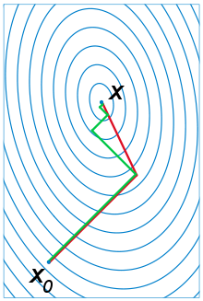
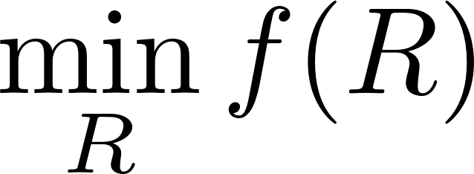
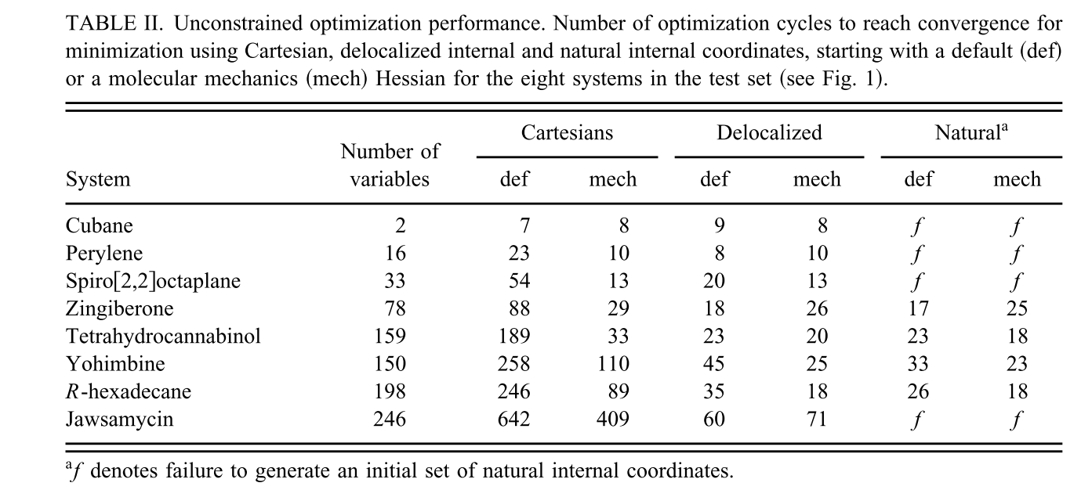
Another Caveat: Optimization Depends on Algorithm and Coordinate System
We want in as few steps as possible
Best are second order methods that use curvature information (second derivatives aka the Hessian)
Newton Method
→ Calculate the Hessian at each optimization
Quasi-Newton Method e.g. BFGS
Update the Hessian (or it’s inverse)
Limited-Memory BFGS
Store only the updates not the matrix
﻿Jon Baker, Alain Kessi, and Bernard Delley, J Chem Phys, 1996, 192-212

Slide 11
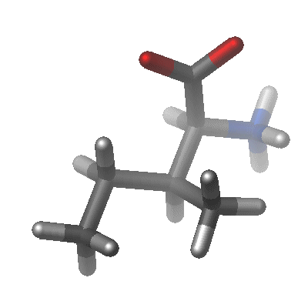
An Important Coordinate System:
Internal Coordinates
Bonds, angles, torsions, improper torsions (e.g. out-of-plane)
Curvilinear
More internal coordinates than 3N-6
Ethene: 12 degrees of freedom, 15+ ICs
Jon Baker and Peter Pulay J. Chem. Phys. 105, 11100 (1996)
https://embnet.vital-it.ch/MD_tutorial/pages/MD.Part2.html
Notes:
Ethylene:
Distance 1-3
Distance 1-4
Distance 4-5
Distance 4-6
Angle 2-1-4
Angle 3-1-4
Angle 1-4-6
Angle 5-4-6
Out-of-Plane 1-2-3-4
Out-of-Plane 4-1-5-6
Dihedral 2-1-4-5
Dihedral 2-1-4-6
Dihedral 3-1-4-5
Dihedral 3-1-4-6

Slide 12
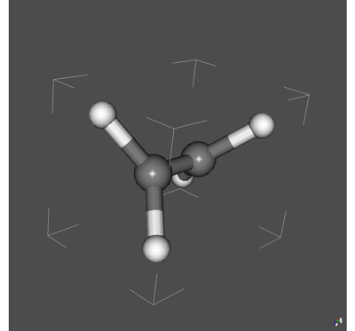
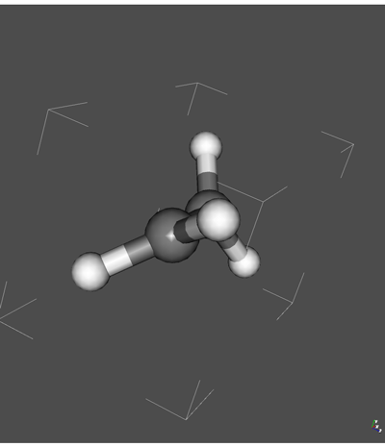
Cartesian Coordinates
Internal Coordinates
Special Properties
The coordinates are less coupled
Mathematically the Hessian (second derivatives of Energy ) is sparse in internal coordinates
The coordinates smoothly interpolate – can be used for simple interpolations (e.g. 1D scans)
They are chemically intuitive!
The energy of a molecules can be parametrized with internal coordinates –> Empirical force field
Challenges…
More degrees of freedom than 3N-6 (redundant) not good for geometry optimization or 3N dimensional interpolation

Slide 13
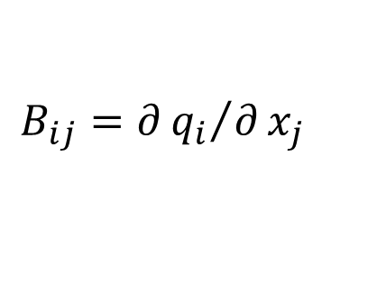
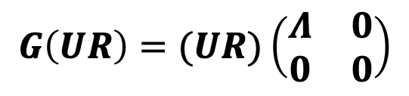
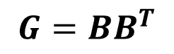
Removing IC Redundancies:
Delocalized Internal Coordinates (DLCs)
3N-6 dimensional
B describes coupling of Ics to Cart
G describes coupling of Ics to each other
U linear combination of Ics that don’t couple
Suitable for geometry optimization
Most QM packages use DLCs for geometry optimization
$$B_{ij}=∂{q_{i}}/∂x_{j}$$
$$G=BB^{T}$$
$$G\left(UR\right)=(UR)\left(\begin{matrix}Λ & 0 \\ 0 & 0\end{matrix}\right)$$
butadiene+ethene
﻿Jon Baker, Alain Kessi, and Bernard Delley, J Chem Phys, 1996, 192-212
Notes:
Make slide before this on minimum spanning bonds

Slide 14
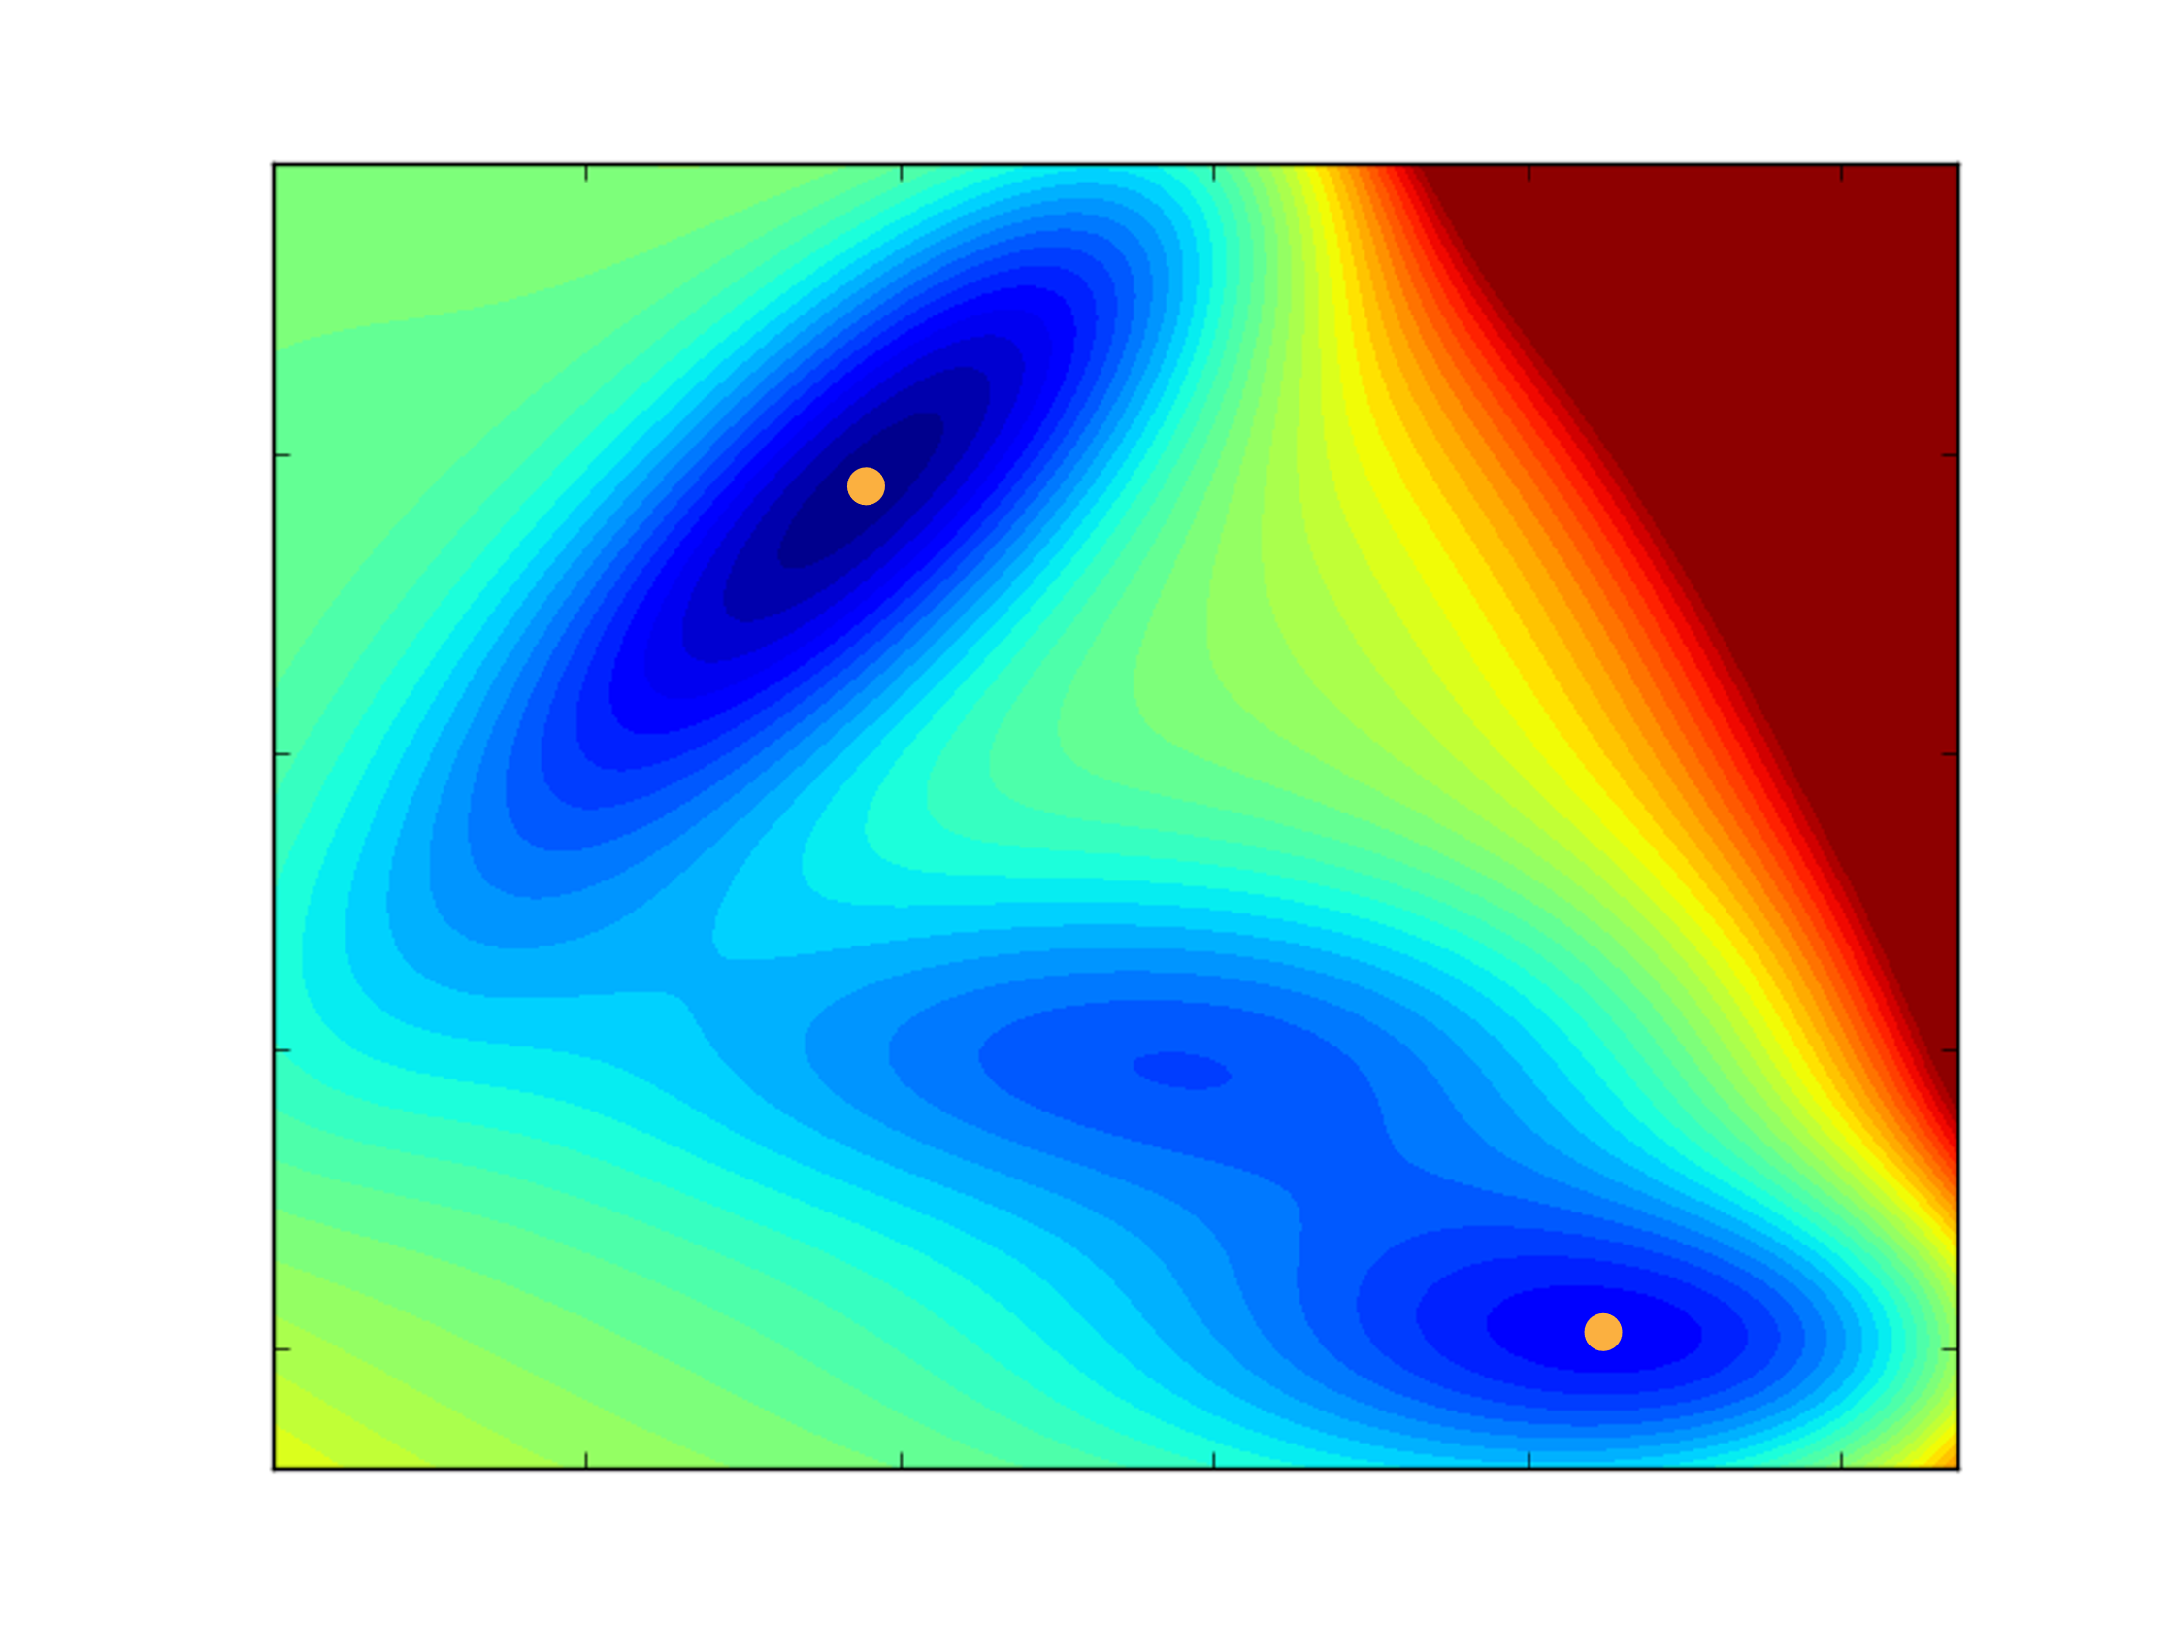

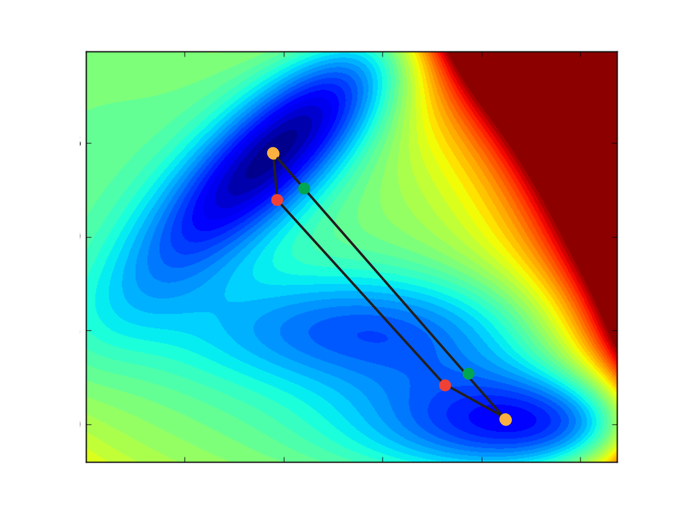

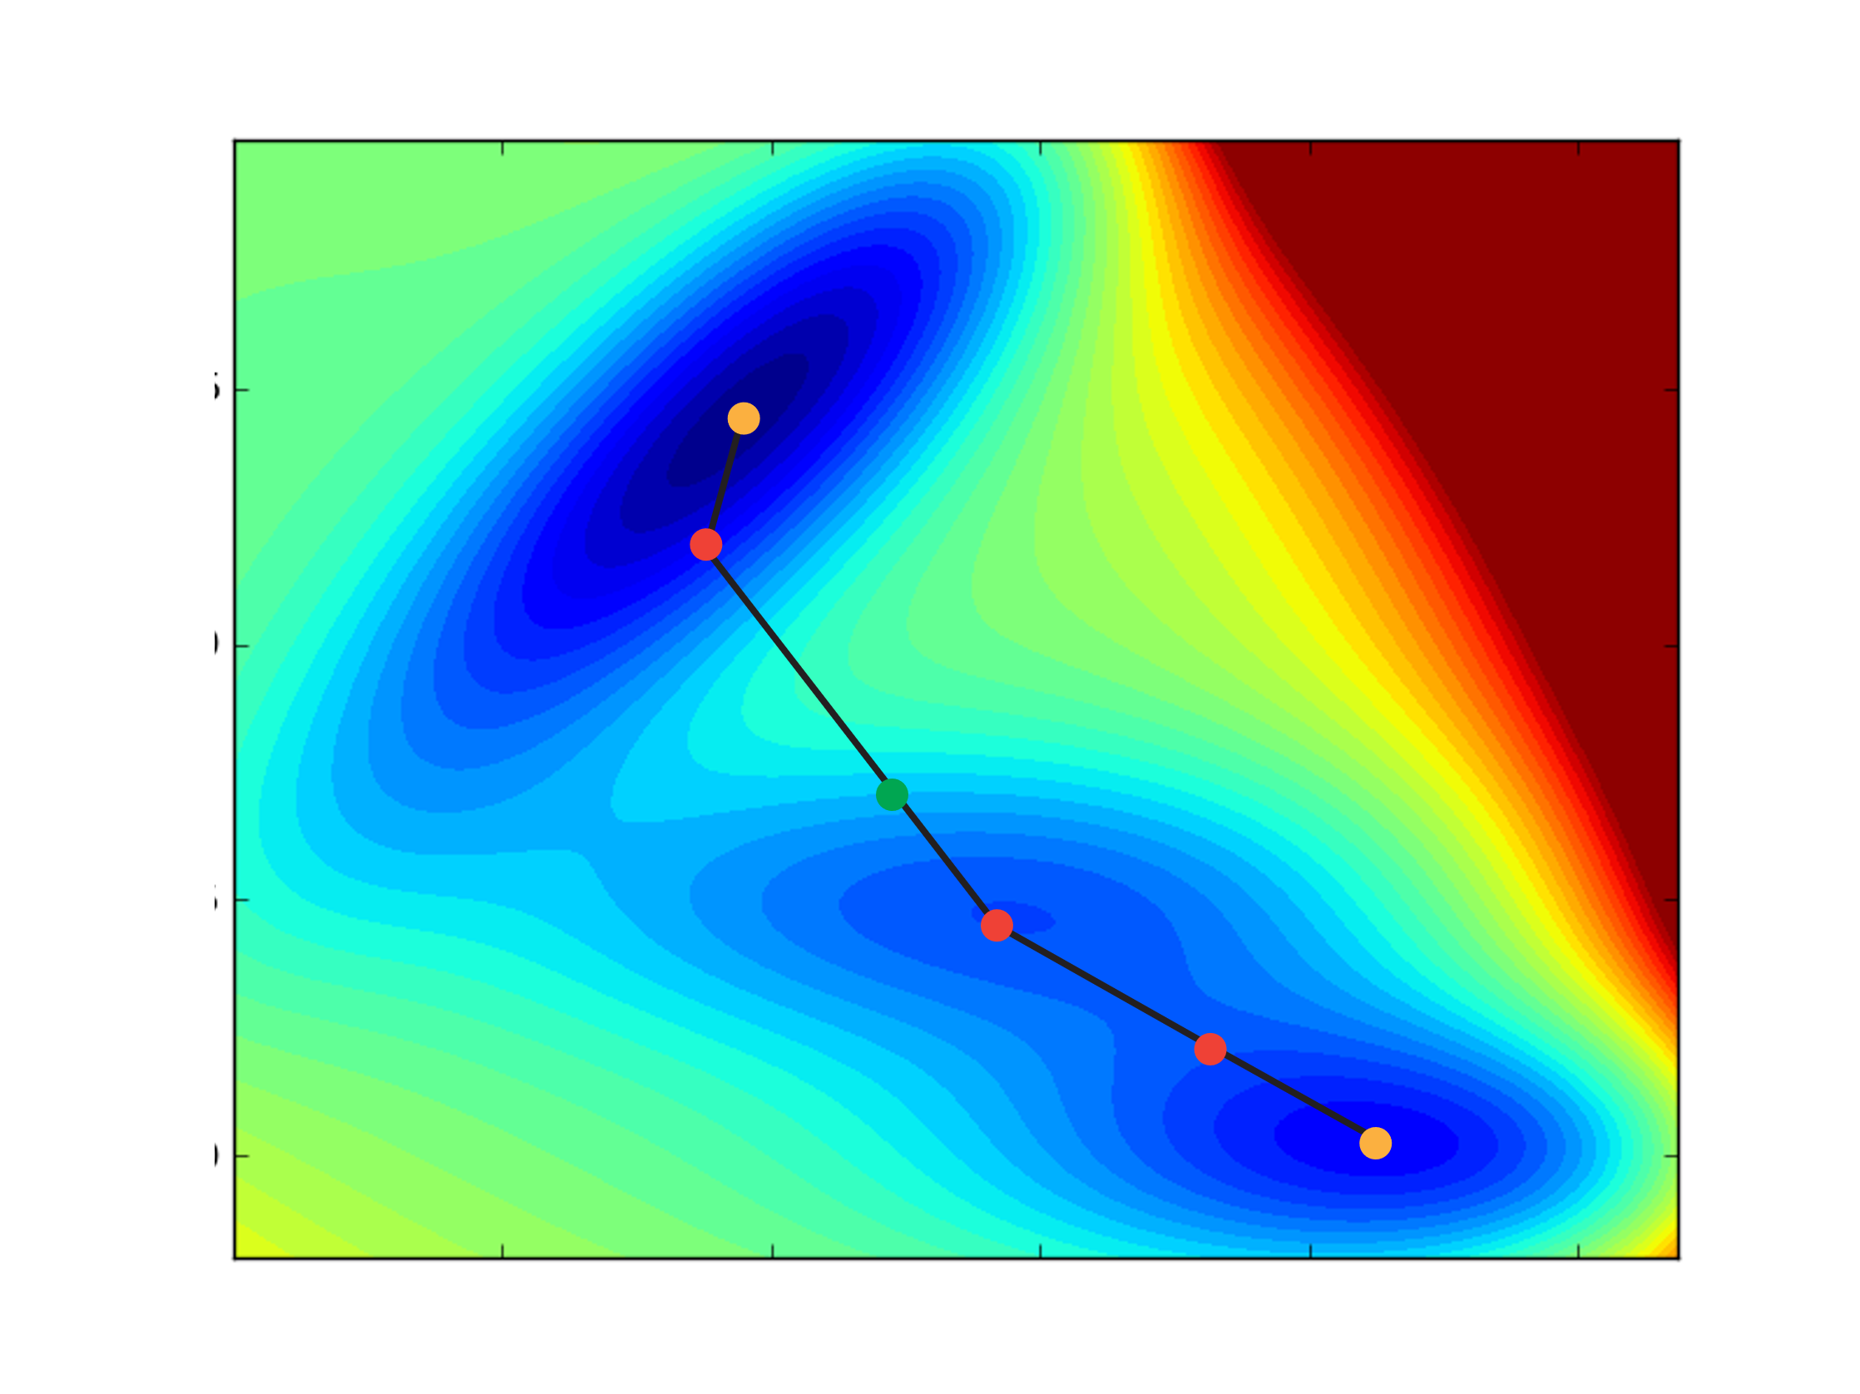
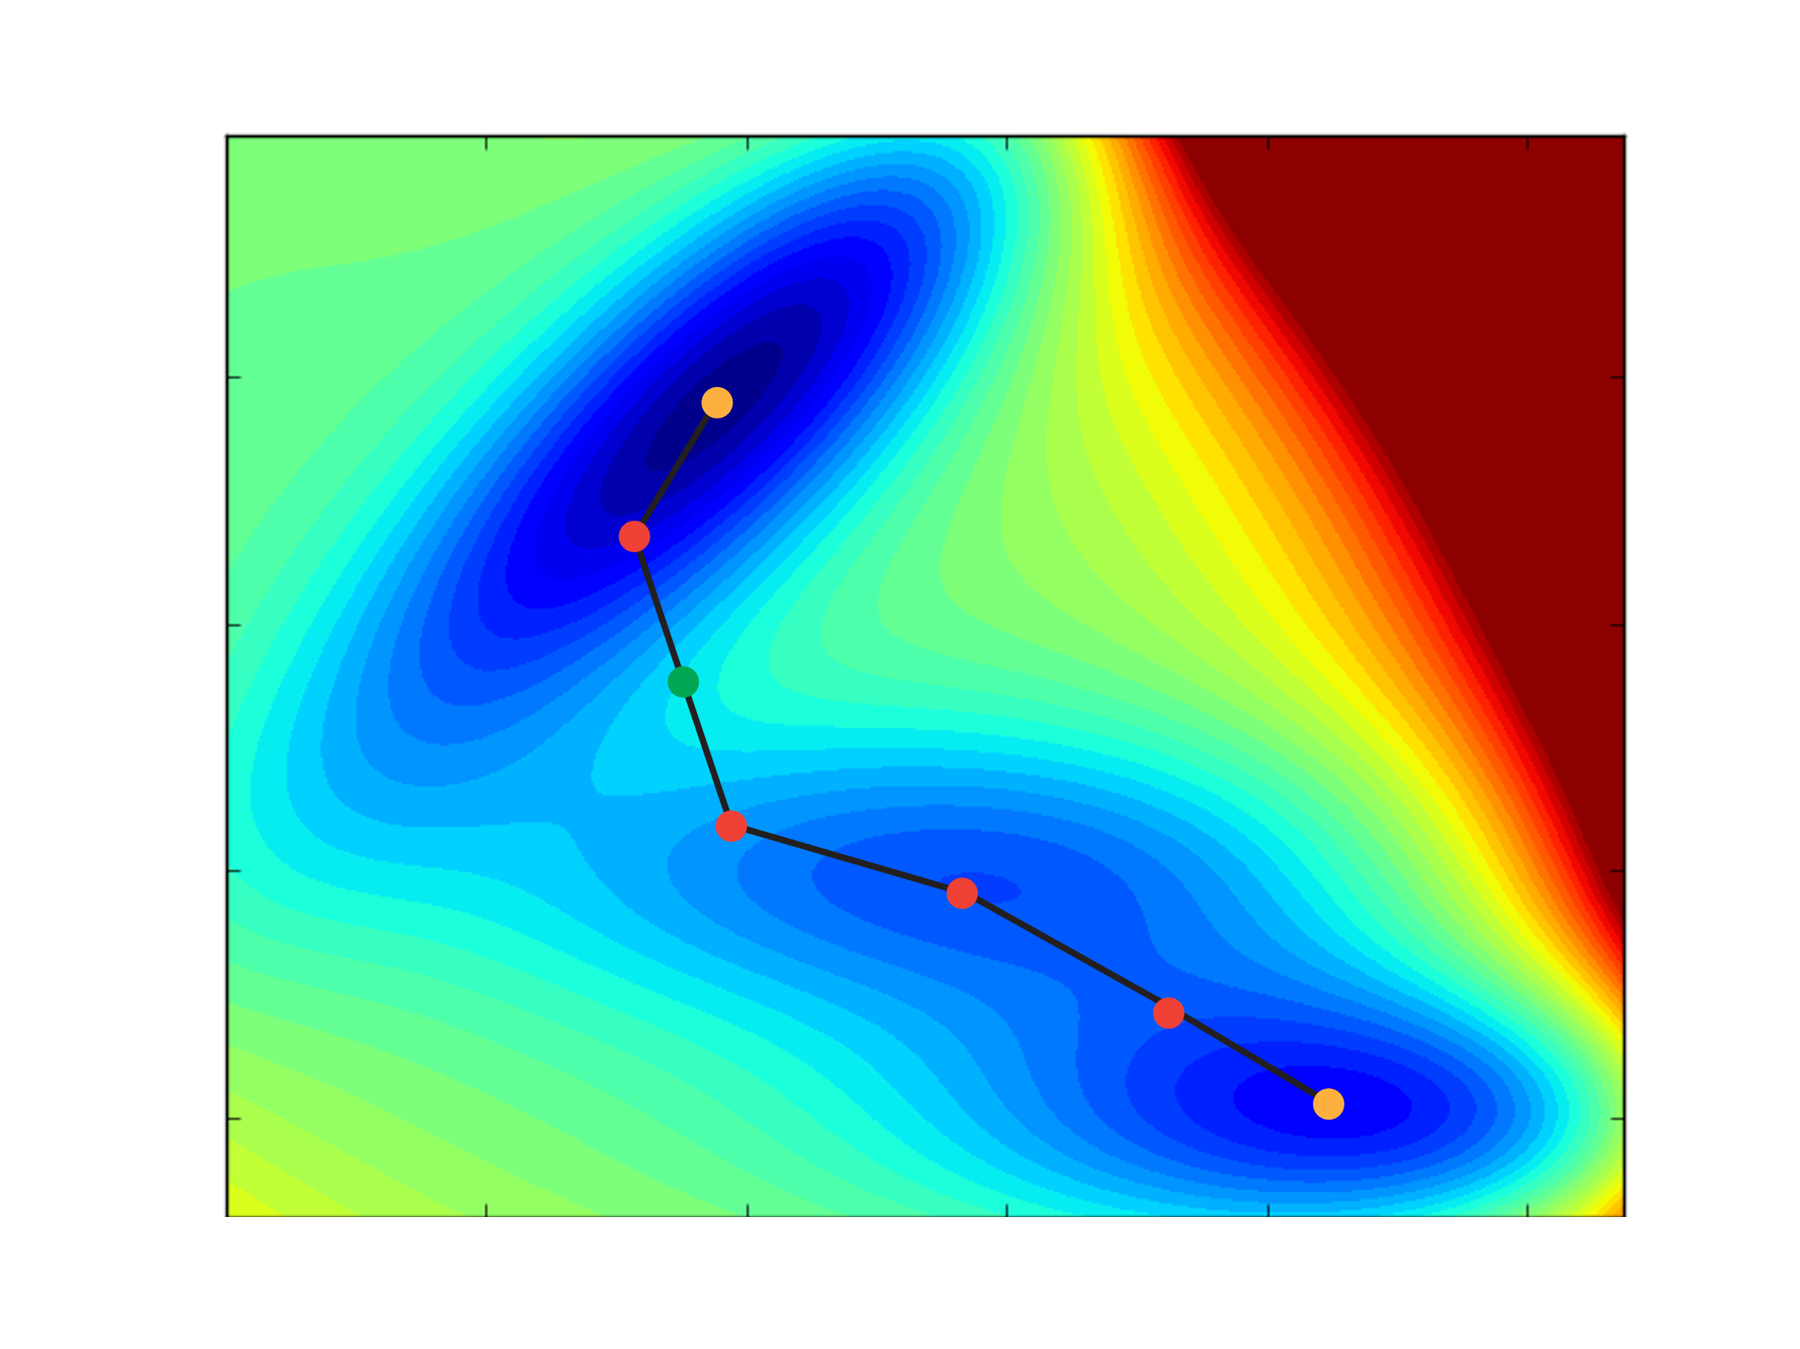
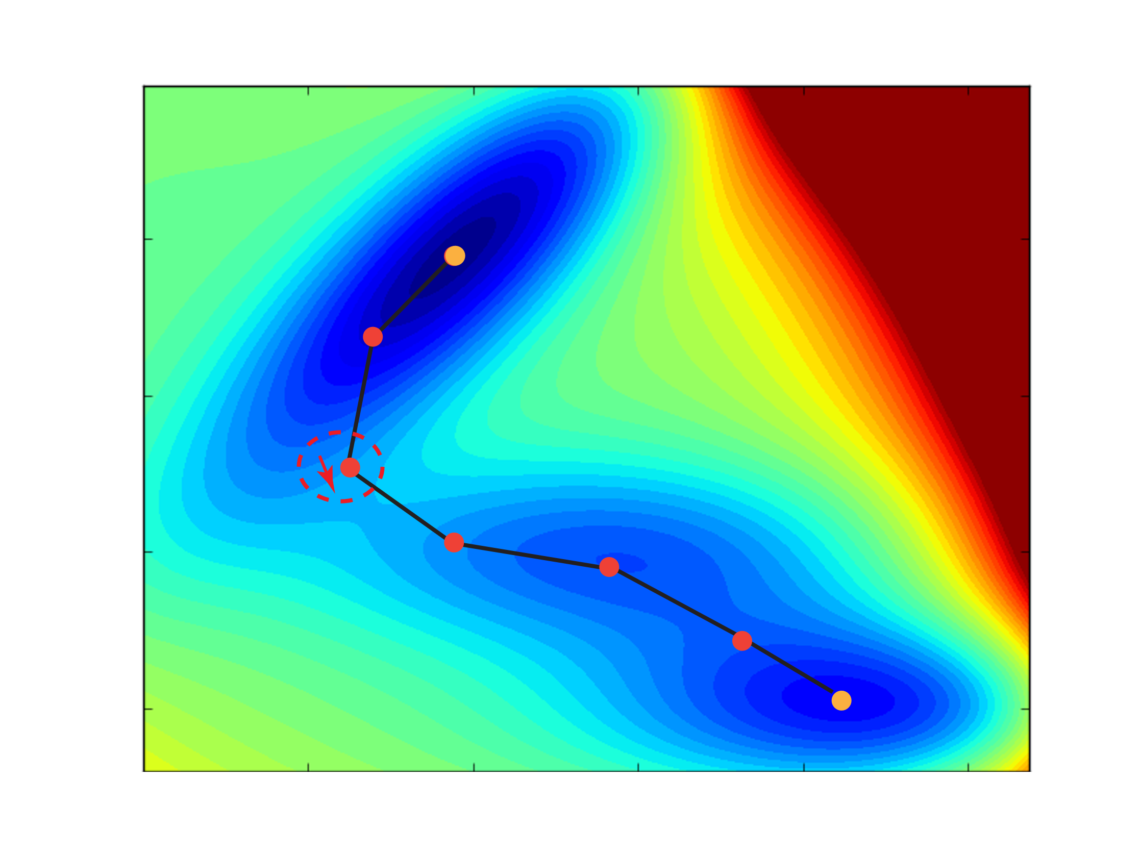

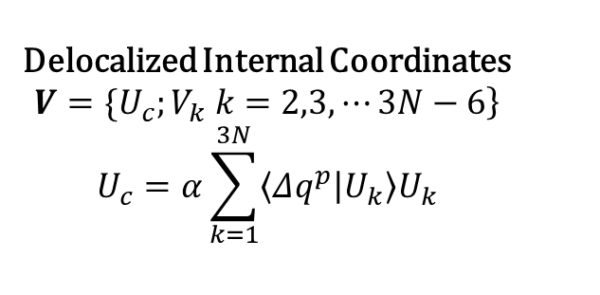
Finding TSs with DLCs: The Growing String Method
Delocalized Internal Coordinates
$$\left.V=\{U_{c};V_{k} k=2,3,⋯3N−6\right\}$$
$$U_{c}=α\sum_{k=1}^{3N}{\left\langle Δq^{p} | U_{k}\right\rangle U_{k}}$$
No need to guess TS structure!
Improved interpolation
Improved geometry optimization
Zimmerman, P. J. Chem. Theory Comput. 2013, 9 (7), 3043–3050. DOI: 10.1021/ct400319w

Slide 15








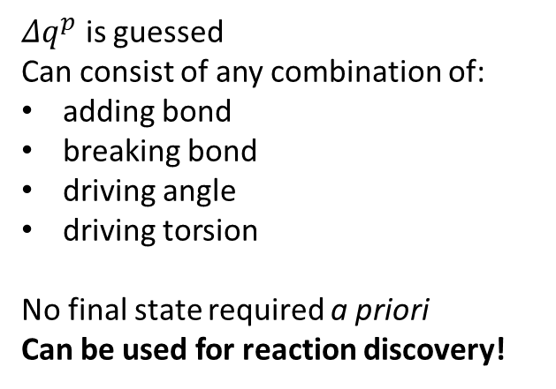

Single-Ended GSM
Delocalized Internal Coordinates
$$\left.V=\{U_{c};V_{k} k=2,3,⋯3N−6\right\}$$
$$U_{c}=α\sum_{k=1}^{3N}{\left\langle Δq^{p} | U_{k}\right\rangle U_{k}}$$
$Δq^{p}$ is guessed
Can consist of any combination of:
adding bond
breaking bond
driving angle
driving torsion
No final state required a priori
Can be used for reaction discovery!
Zimmerman, P. M. J. Comput. Chem. 2015, 36 (9), 601–611. DOI: 10.1002/jcc.23833

Slide 16
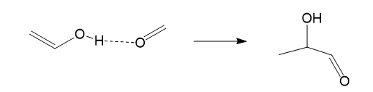
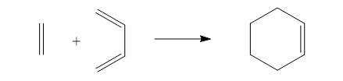
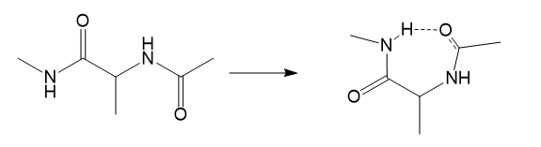
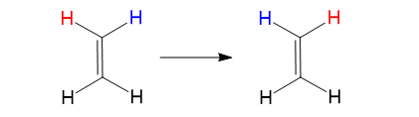
Examples
H3
3
1
3
1
2
ADD 2 3
BREAK H3 3
ADD H3 1
ADD 1 3
ADD 2 4
2
4
1
1
4
2
2
3
3
TORSION 1 2 3 4 0.
4
TORSION 1 2 3 4 180.

Slide 17
Goal of Today:
We will be using molecular mechanics (AMBER) and the single-ended growing-string method to investigate the rate limiting helix inversion of molecular motors
Which modifications of Feringa motors is the fastest and why?
How do the computations compare to literature?
Fine Tuning of the Rotary Motion by Structural Modification in Light-Driven Unidirectional Molecular Motors. JACS, 128, 2006, Feringa et. al

Slide 18
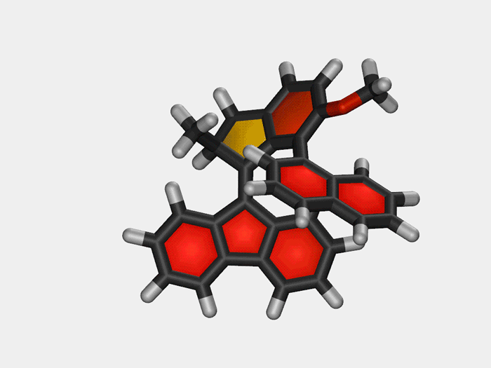
Molecular Motors: Nobel Prize 2016
https://cen.acs.org/articles/95/i23/Molecular-motor-turns-rotor.html

Slide 19
Details for Bonus Question: Molecular Mechanics:
Equilibrium terms
r_{eq} : bonds
θ_{eq} : angles
n : dihedral multiplicity
γ : dihedral phase
Force Constants
Kr : bonds
K_{θ} : angles
V_{n} : dihedral
http://ambermd.org/antechamber/gaff.html#summary

Slide 20
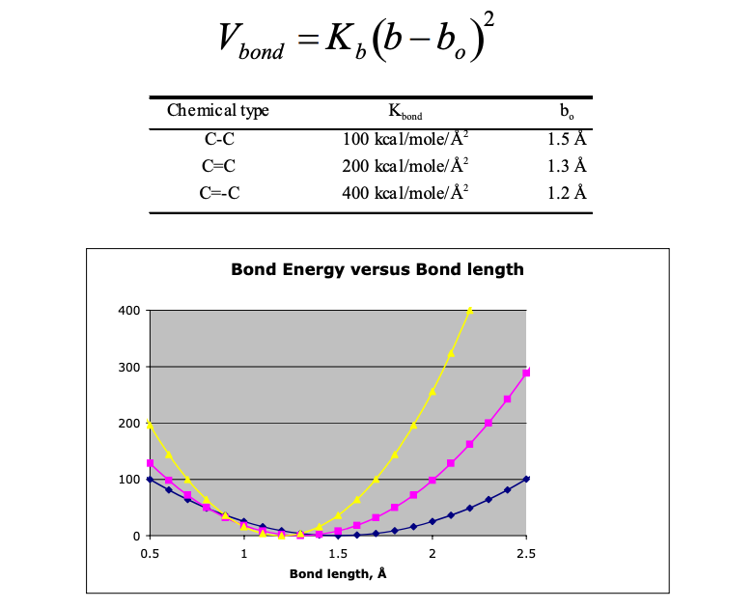
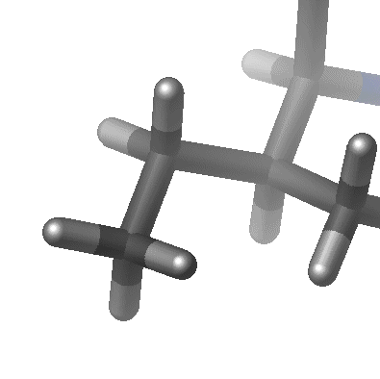
Bonded Terms
Values of force constant are often evaluated from experimental data such as infrared stretching frequencies or from quantum mechanical calculations. Values of bond length can be inferred from high resolution crystal structures or microwave spectroscopy data.

Slide 21
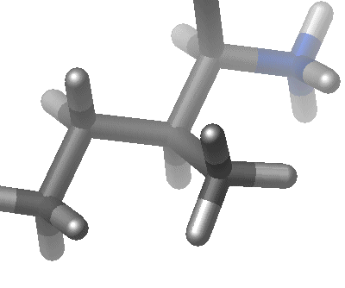
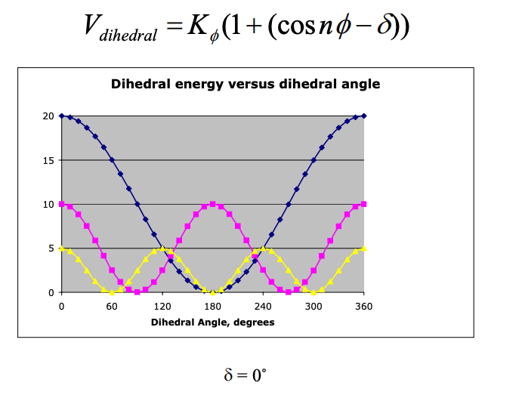
Bonded Terms
The parameters for the these terms, Kb, Kq, Kf, are obtained from studies of small model compounds and comparisons to the geometry and vibrational spectra in the gas phase (IR and Raman spectroscopy), supplemented with ab initio quantum calculations.

Slide 22
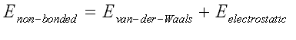
Non-Bonded Terms
The van der Waals interaction is most often modelled using the Lennard-Jones 6-12 potential which expresses the interaction energy using the atom-type dependent constants A and C. Values of A and C may be determined by a variety of methods, like non-bonding distances in crystals and gas-phase scattering measurements

Slide 23
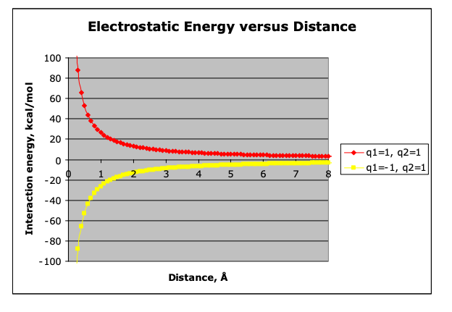
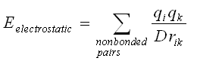
Non-Bonded Terms
The electrostatic interaction between a pair of atoms is represented by Coulomb potential; D is the effective dielectric function for the medium and r is the distance between two atoms having charges qi and qk.

